Slide 1
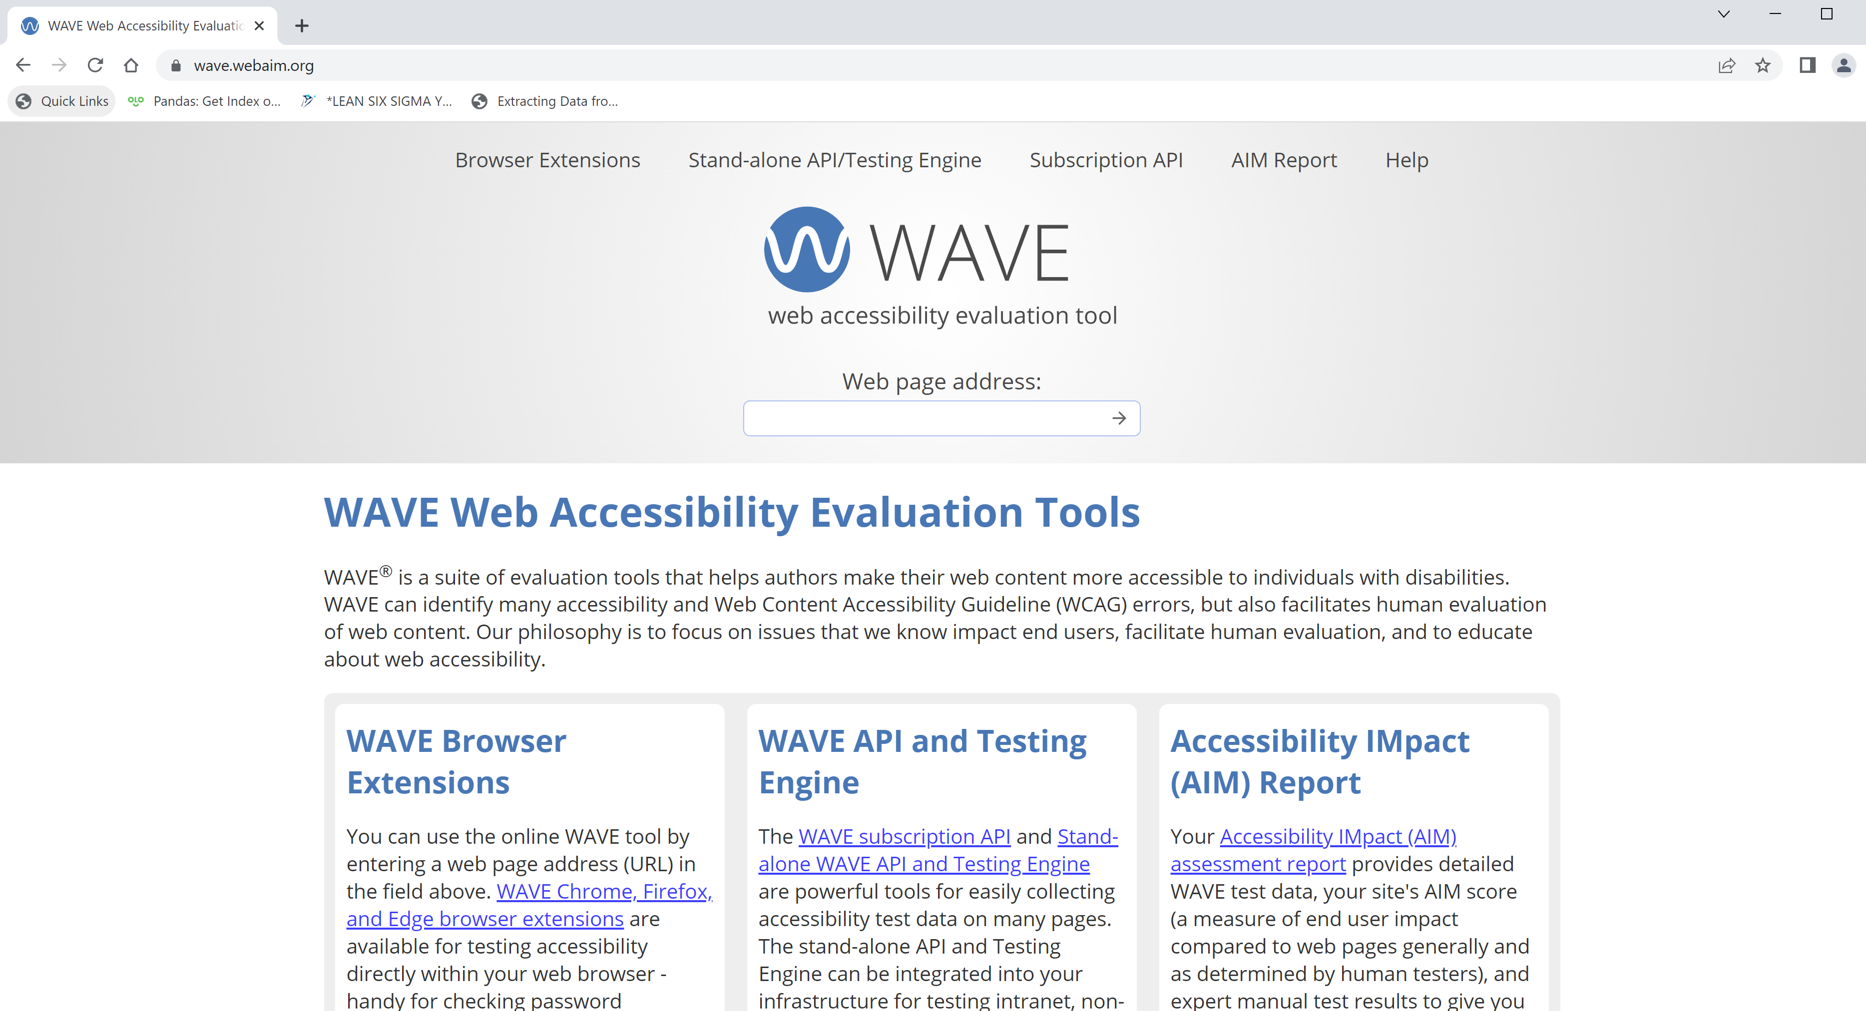
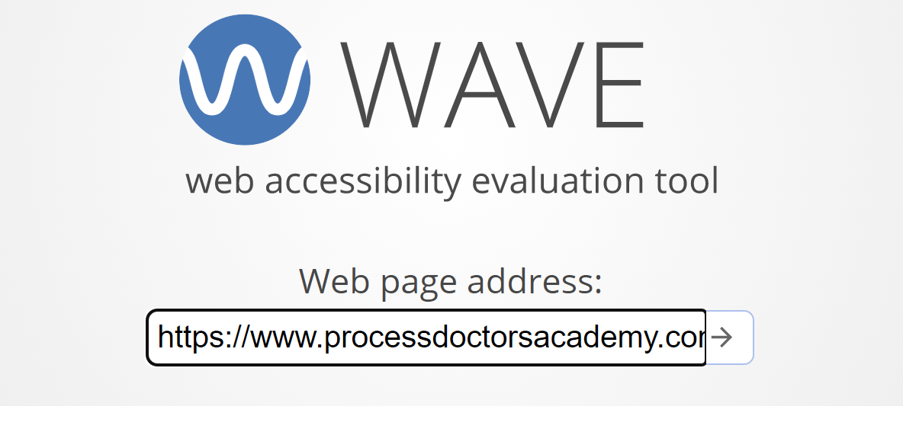
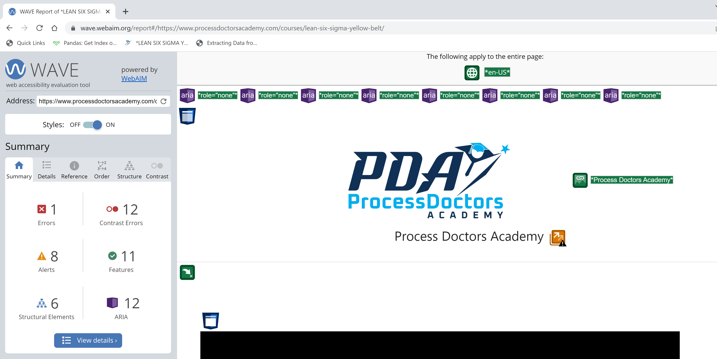

1. Access wave.webaim.org
2. Type in the website’s url to check in the Web page address input field. Then submit

Slide 2
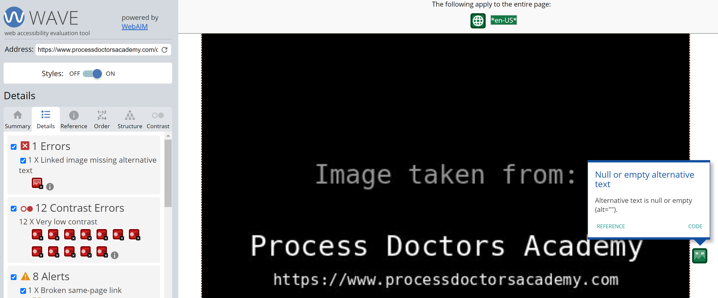




3. Check Accessibility check results.
4. Validate indicated details and log/escalate accordingly.

